Slide 1
WHAT’S IN CROSSWORLDS IN DETAIL
Past the initial overview… Let’s get to see what you can gain

Slide 2
TECHNOLOGY ENABLER
Bring to Domino developers an easy way into J2EE
Bring to J2EE the full power of Domino
Bring to customers the best of both worlds

Slide 3
WHAT CAN I DO WITH CROSSWORLDS
J2EE APPS
WebProfile 6.0 (JSP 2.2, Servlet 3.0+31,WebSockets)
OSGI APPS
WAB / EBA
Extensions & services

Slide 4
Who Am I?
Daniele Vistalli (www.twitter.com/danielevistalli)
Founder & CTO at Factor-y S.r.l.
Java developer & architect (Java 1.0.2+ on OS/2)
Domino Developer & architect (Notes 4.5+)
WebSphere Developer & architect (WAS 3.5+)
R&D guy / geek / lazy developer (lazyness favours invention)

Slide 5
The DEVELOPMENT MODEL PROBLEM
NSF/Domino is NoSQL since before NoSQL existed
Powerful security and replication infrastructure
Great at handling attachments/binary data
Great at workflow
Modern developers don’t get Domino (they call it legacy… then they set off for less mature NoSQL solutions)

Slide 6
The WEBSPHERE PROBLEM
Notes/Domino developers failed to invest into WebSphere / J2EE due to wrong myths:
J2EE is slow / cumberstone … (not anymore since a long time)
WebSphere is evil (the IBM Workplace product created this perception in Notes shops)
In 2015 we need to move on. Java / J2EE are the way you may choose with productivity at hand

Slide 7
The REAL PROBLEM
There are 10 million NSF applications deployed at customers. Notes shops (customers / partners) need to:
Integrate (with other systems)
Modernize (mobile, responsive, restful, oauth)
Be productive and simplify application development
Exploit any available tool

Slide 8
What is CROSSWORLDS?
WebSphere Liberty (8.5.5.4) +
IBM Domino (9.0.1) +
OpenNTF Domino Api +
CrossWorlds feature for Liberty

Slide 9
Websphere Liberty
A fast J2EE Application Server built by IBM for modern needs.
Light (< 40 Mb ram, < 5sec startup)
Open (OSGI based + J2EE 6 / 7)
Constantly evolving
Extensible (customizable to the limit)
Easy to manage (unzip & run, no install needed)

Slide 10
IBM Domino (9.0.1)
You should know it ☺
What we care about is
Advanced storage facility (NSF), schema free
Replication and distributed server topology
Native/embedded security model (+LDAP)
Provides native binding for Java (Notes.jar / napi)

Slide 11
OpenNTF Domino Api
An OpenNTF project that gets you:
Modern Java constructs on top of Notes.jar API
Extra goodness:
Graph API
HyperSearch/Index
Xots (agent-manager free Agents)
Much more (look on slideshare for good content)

Slide 12
CrossWorlds feature
An exstension for the WAS Liberty application server
Embeds ODA as an OSGI component
Manages initialization and lifecycle of the Domino integration (can provide NSF services even if the Domino server is not running)
Zero effort setup for developers & sys-admins
Is the foundation for future work (auto-config, extensions, Websphere helpers)

Slide 13
WHAT CAN I DO WITH IT ?
Exploit any J2EE / Java library
Exploit Java 1.7/1.8 (Domino still on 1.6)
Manage security your way
Notes:
Neo4J 1000 times faster than MySQL
OrientDb benchmarks
Giraph

Slide 14
J2EE exploitation for domino
JAX-RS for Rest (the J2EE way)
JAX-WS for WebServices (the J2EE way)
Spring, Struts, other framework ? YES
Choose your own
Async servlets / higher scalability
plus
Java Batch
Scheduler / managed threads
OSGI application model

Slide 15
Java 1.7/1.8 at hand
Domino JVM is 1.6
WAS Liberty can run on 1.6/1.7/1.8
You can build your reusable frameworks or exploit existing frameworks for your apps.
Not tied anymore to IBM’s choices for Domino

Slide 16
Manage security your way
Trusted Authentication Interceptors (TAI) allows to define your custom system for authentication and SSO (add Oauth, Saml, custom)
ODA services allow the creation of:
Trusted sessions: CrossWorlds is a gateway to any database on any server in the domino network
Named sessions: CrossWorlds sessions can proxy any user and run code on their behalf
Exploit LTPA (Domino and Liberty share config)
Exploit LDAP (Liberty uses the same servers as Domino)

Slide 17
EARLY EXPERIENCe
We’re building it
MacOSX is at hand
Start looking into WebSphere Liberty
Getting started app

Slide 18
We are building it
CrossWorlds went from idea to reality in the days between December 20 2014 and December 31 2014
Most of the discussion is happening at OpenNTF Domino Api chat group on Skype
We’re doing tests, building stuff, testing things out

Slide 19
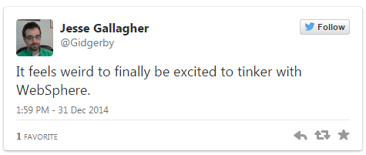
MACOSX is at hand
Our hacks got results..
Jesse Gallgher (@Gidgerby) got CrossWorlds running on a Mac with native access to domino using the client libraries.
Notes Client + WAS Liberty + CrossWorlds = modern development for domino on Mac

Slide 20
LOOK for Liberty
IBM has invested a huge amount in making WebSphere Liberty a great application server
BlueMix runs on Liberty
Start looking at it today
https://developer.ibm.com/wasdev/docs/introducing_the_liberty_profile/
https://developer.ibm.com/wasdev/docs/category/getting-started/

Slide 21
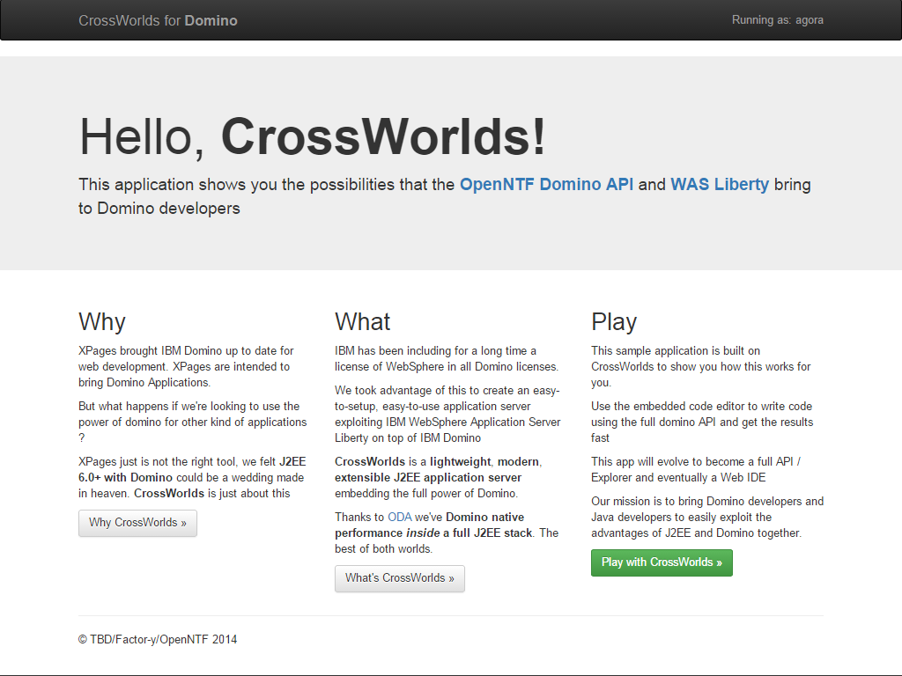
Getting started
I’ve created a sampler APP (included) It provides a web based groovy shell allowing you to test out ODA code from your browser.

Slide 22
LEGAL
All in

Slide 23
ALL In
I’ve been looking into the topic of WebSphere Liberty licensing. I need to get confirmation from IBM’s legal but here’s what’s going on:
XWork Server, Domino Collaboration Express, Domino Enteprise all include entitlement for IBM WebSphere Network Deployment
WebSphere Network Deployment includes WebSphere Liberty
All you need is already in the server license for your domino servers
Don’t hold back, go get it.

Slide 24
What’s next
Technical overview
OpenNTF project ?

Slide 25
Technical Overview
I’m working on another presentation to describe how CrossWorlds works and the requirements of it.
I hope to be getting feedback to this introduction and then prepare a technical presentation going deeper into it.

Slide 26
OpenNTF project
My company (Factor-y S.r.l.) is a member of OpenNTF. We’ve so far not contributed anything.
If CrossWorlds meets the requirements we’ll share it as our initial contribution and establish CrossWorlds (or whatever final name we take) as an OpenNTF project.

Slide 27
Thanks
Thanks to all the guys in the OpenNTF Domino API team and chat for the support in making this happen
Nathan T Freeman / Roland Praml / Paul Withers for helping me understand ODA
Jesse Gallagher for testing out my stuff and making it work on MacOSX
Everybody else for the fun of the discussion that’s going on
As per Nathan motto: “We do what we must because we can”

Slide 28
References
https://github.com/Factor-y/CrossWorlds
https://developer.ibm.com/wasdev
https://github.com/OpenNTF/org.openntf.domino

